Slide 1
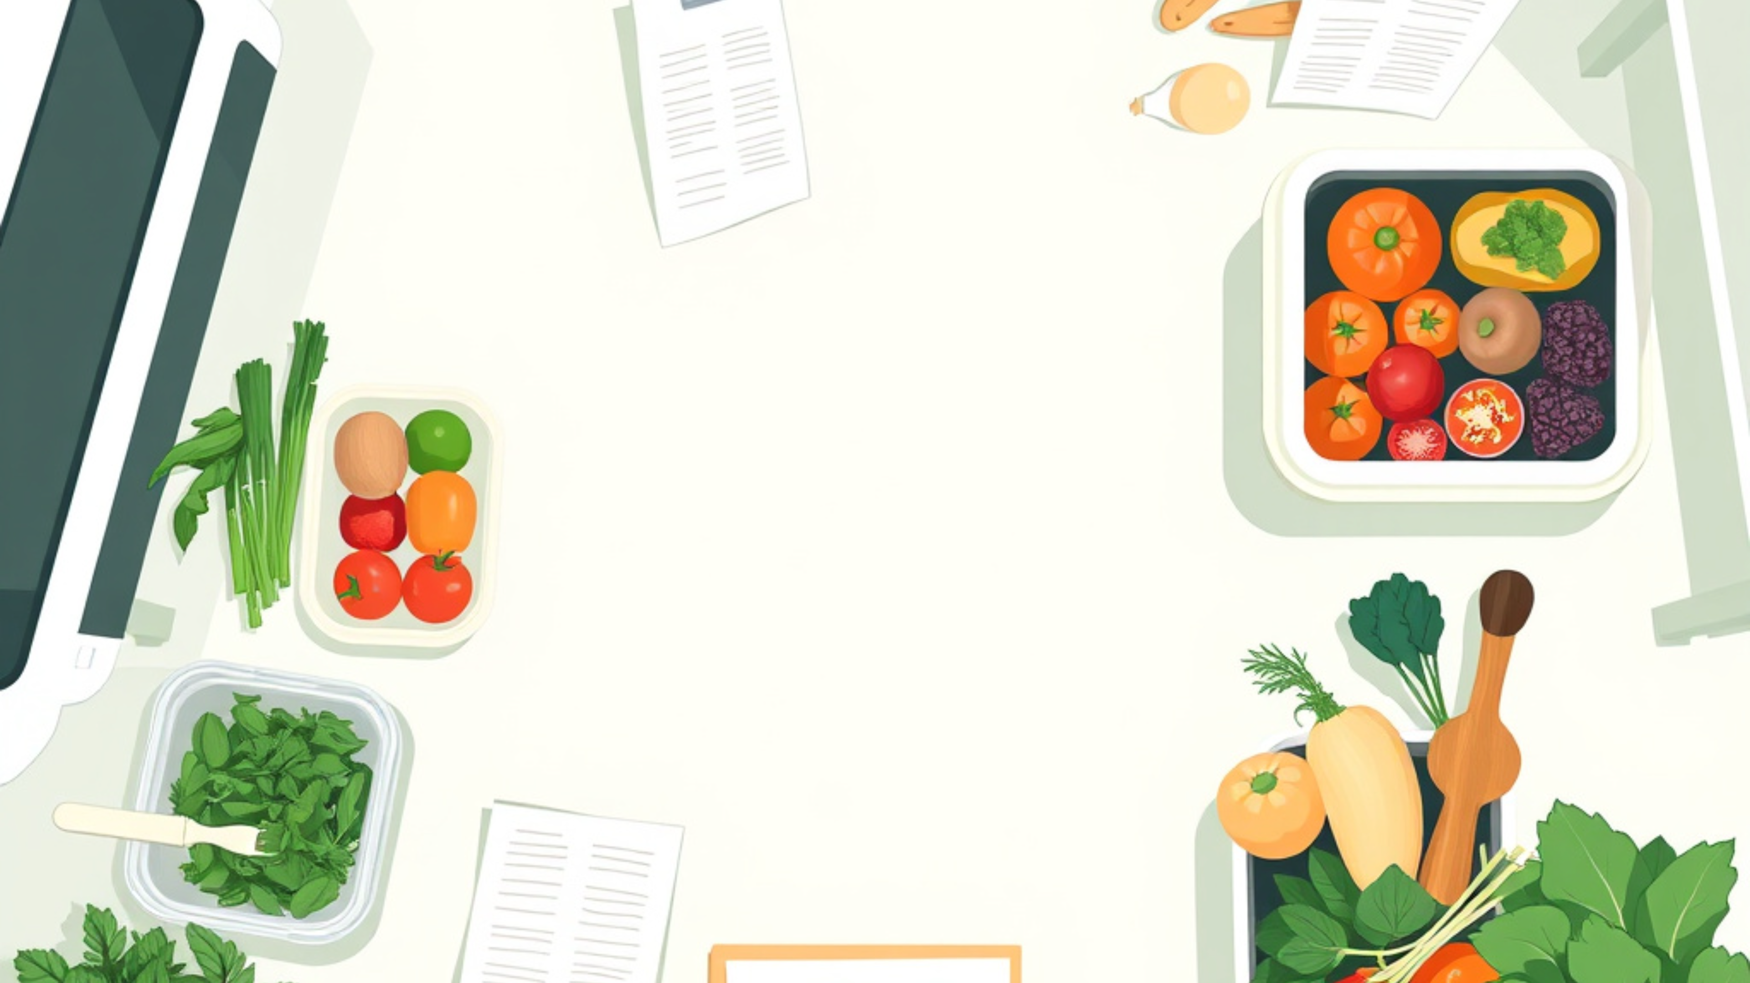

Weekly Meal Planner & Grocery List Generator
A Console-Based Java Application
G Sahasra(2620090001)
SK Varsha(2620030008)

Slide 2

THE PROBLEM
Weekly meal planning breaks down in the details.
The routine is repetitive, easy to miss, and costly when ingredients do not line up.
Where the friction shows up
01
Planning meals for a week is repetitive and easy to mess up.
Small misses add up.
Without a clear plan, people overbuy, underbuy, or waste food.
02
Ingredients are easy to forget while shopping.
03
Combining ingredients across meals is tedious.
The shopping list is the symptom.

Slide 3




PROJECT OBJECTIVES
Objectives
Turn weekly meal planning into a simple, useful Java console experience.
Plan the Week
Automate Groceries
Learn by Building
Make weekly meal planning faster, clearer, and easier to repeat.
Generate a grocery list directly from the meals already on the plan.
Practice core Java concepts through a tool with a real everyday purpose.
•Choose meals with less guesswork
•Combine ingredients automatically
•OOP, collections, and loops
•Keep the routine organized
•Shop with a focused list
•File I/O in a complete workflow
The goal:
a small console tool that genuinely makes meal planning easier.

Slide 4






MEAL PLANNER
Key Features
Everything you need to turn weekly meals into an organized plan.
Plan your week
See the full plan
Shop with ease
Add meals and ingredients for every day.
View every meal in one clear weekly layout.
Generate one grocery list from all planned meals.
Edit or remove anytime
Know what is coming next
From plan to pantry

Slide 5






JAVA FOUNDATIONS
Java Concepts Used
The meal planner combines core language features with practical input and file behavior.
Language Features
Input & Reliability
Object-oriented design
File handling
Classes and objects model Meal, MealPlanner, and GroceryList.
Reads and writes meal-planning information for continued use.
Collections and control flow
User input and exceptions
ArrayList, HashMap, loops, and conditionals organize meals and ingredients.
Scanner captures choices while exception handling keeps the program dependable.
Structure turns a recipe idea into reusable code.
Good input handling keeps meal planning on track.

Slide 6


ARCHITECTURE · CORE RESPONSIBILITIES
System Design / Class Structure
A simple separation of data, planning logic, grocery output, and user flow.
DOMAIN MODEL
APPLICATION FLOW
Data & planning
Output & coordination
Meal
GroceryListGenerator
Stores a meal name and its ingredients list.
Generates a grocery list and merges duplicate ingredients.
MealPlanner
Owns the weekPlan map, with methods to add meals and view the plan.
Main
Runs the menu loop and coordinates the application flow.

Slide 7






APPLICATION WORKFLOW
From meal entry to a ready weekly plan
A simple three-step flow turns daily choices into an organized shopping list.
WORKFLOW AT A GLANCE
01
02
03
Capture daily meals
Store the plan
Build the output
Meals are organized in an ArrayList and HashMap.
Display the weekly plan and merge duplicate ingredients.
User enters meals for each day.
Plan once.
Shop smarter.
The result: one clear plan, with a cleaner ingredient list.
Structured data keeps the kitchen workflow practical.

Slide 8


WEEKLY MEAL PLANNER · SAMPLE RUN
Sample Console Output
A simple terminal flow turns meal choices into a ready-to-use grocery list.
grocery-planner.exe
WHAT THE RUN SHOWS
===== Weekly Meal Planner ===== Enter meal for Monday: Pasta with Tomato Sauce Ingredients: pasta, tomato sauce, garlic Enter meal for Tuesday: Grilled Chicken & Rice Ingredients: chicken, rice, garlic ... ===== Weekly Grocery List ===== - pasta - tomato sauce - garlic (x2) - chicken - rice Grocery list saved to grocerylist.txt
Input becomes action.
The program collects meals, combines ingredients, and saves the final list for shopping.
KEY DETAIL
garlic (x2)
Repeated ingredients are counted once, with the quantity preserved.

Slide 9



TECHNOLOGY STACK
Tools & Technologies
A practical toolkit for building, testing, and running the application.
Development
Workspace
Runtime tools
JDK
IDE
CLI
Scanner input + Collections API
Java JDK for development
Eclipse or IntelliJ for coding

Slide 10





REFLECTION
Challenges & Learnings
What the build taught me about structure, data, and reliability.
Challenges
Learnings
Duplicate ingredients
Practical OOP structure and class design
Invalid input
ArrayList and HashMap working together
Nested data
Reading and writing files in Java
Each edge case exposed a place where structure mattered.
Better structure makes future changes easier to manage.

Slide 11



ROADMAP
Future Enhancements
A practical next step: make meal planning smarter, richer, and easier to share.
A friendlier interface
Add a GUI with JavaFX or Swing.
NEXT HORIZON
From a useful planner
to a complete kitchen tool.
Plans that persist
Store plans in a real database.
More intelligence behind every plan, with a smoother experience from idea to grocery bag.
More useful output
Add nutrition and calorie information, plus PDF grocery-list export.

Slide 12

Thank You!

